Slide 1
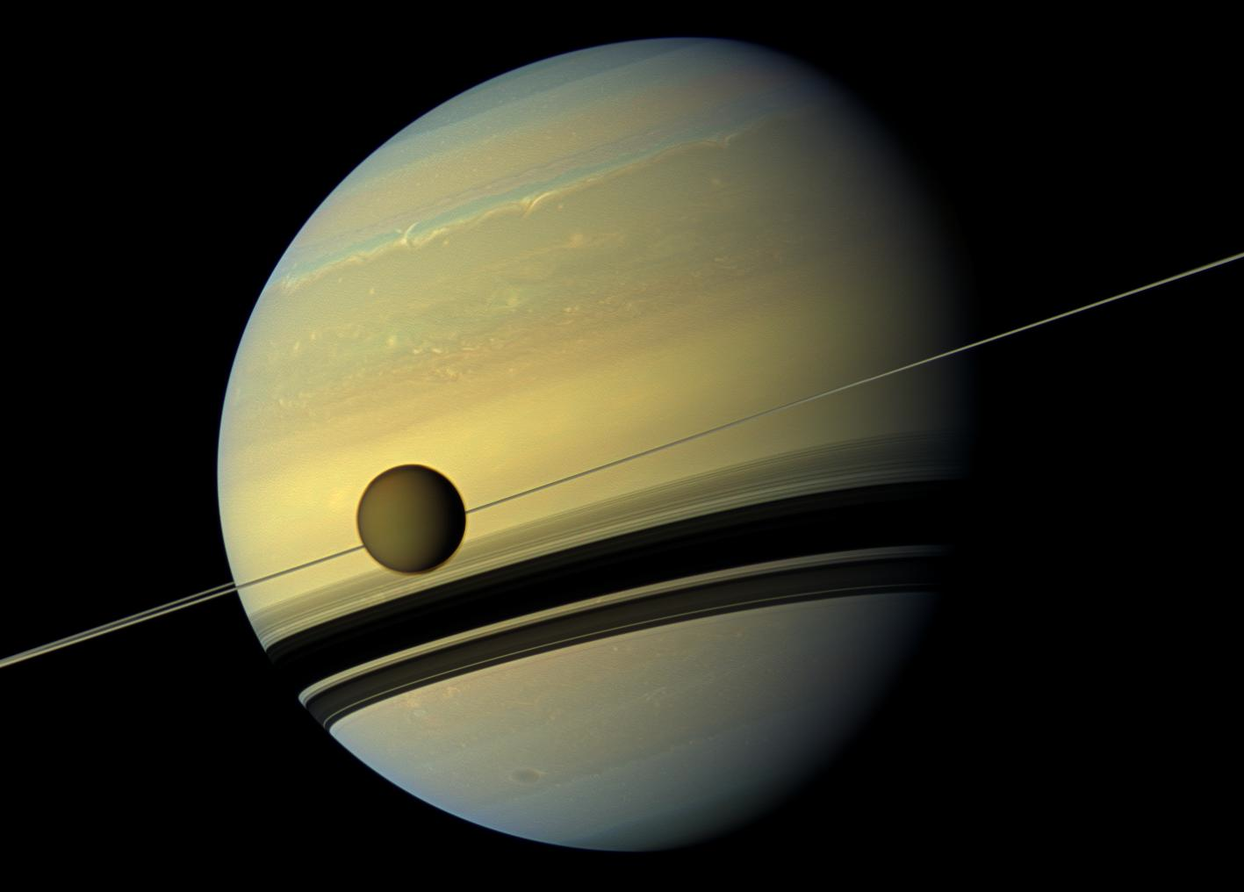


Titan & disc averaged spectra
Nick Teanby
School of Earth Sciences, University of Bristol, UK

Slide 2
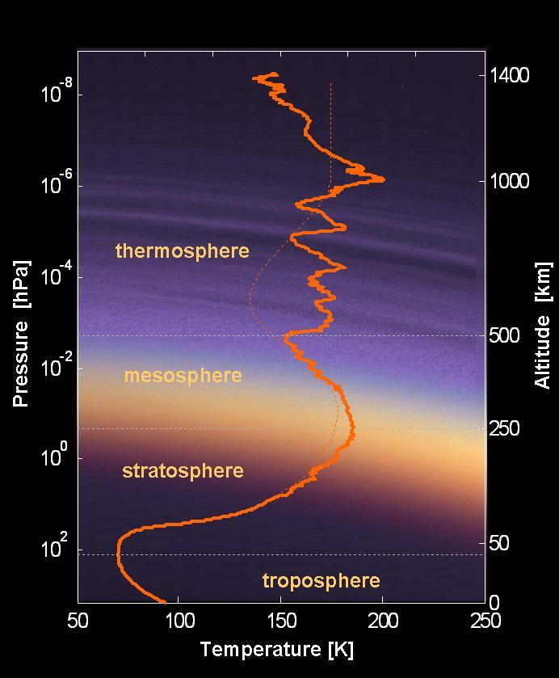

Titan Key Features
Surface
Small (radius 2575 km)
Cold
N₂/CH₄ atmosphere (1.5bar @surface)
Lots of trace gases / photochemistry
Hydrocarbons
Nitriles
Extremely variable spatially/temporally
Hazes (multiple types)
Liquids
Extended atmosphere (low gravity)
Huygens probe provides a good T(p) apriori

Slide 3
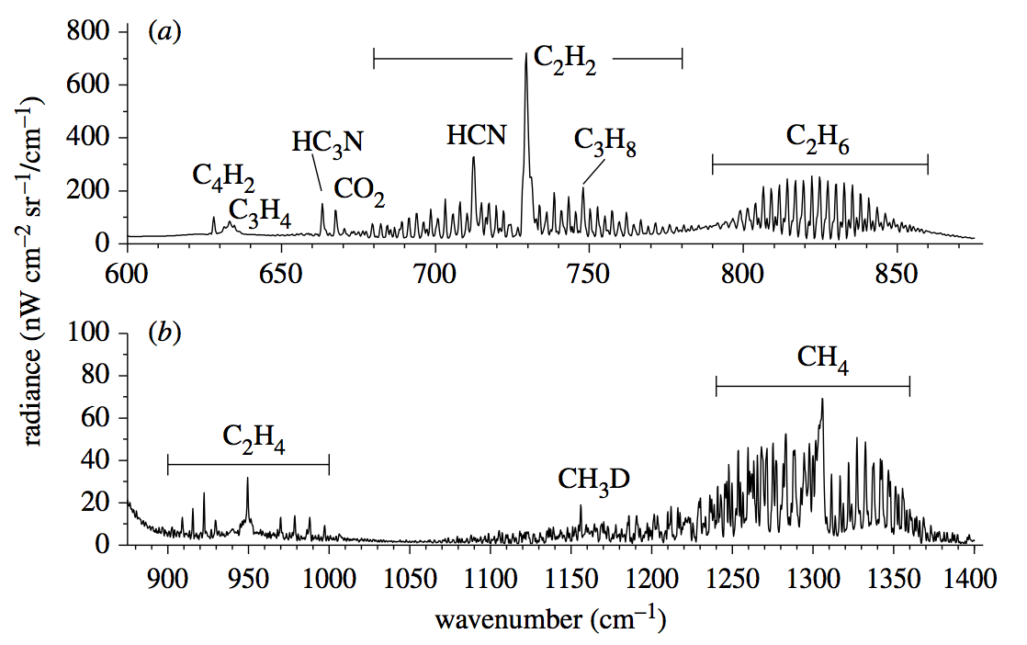
Cassini/CIRS Spectrum of Titan [Teanby et al 2009]

Slide 4
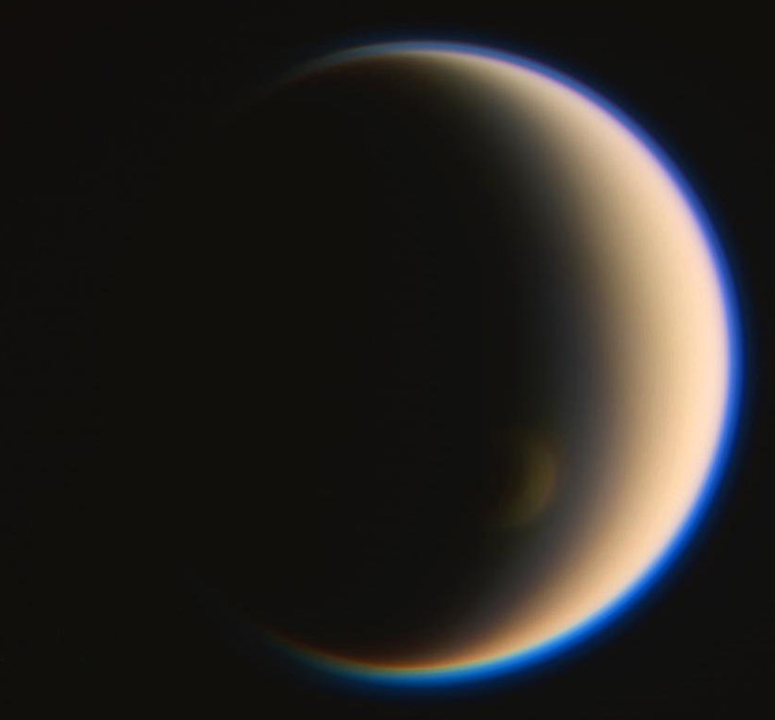
Titan (resolved)

Slide 5
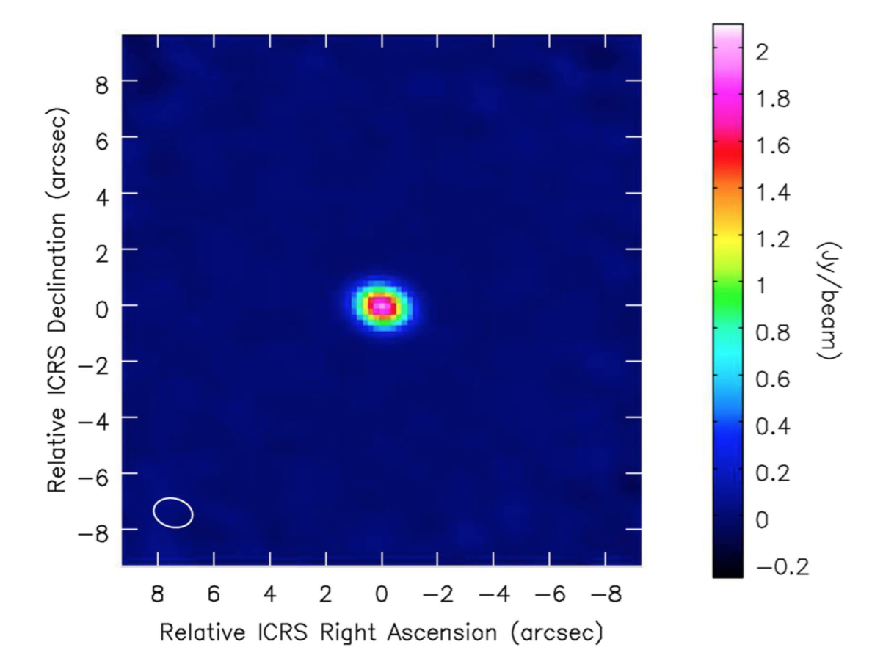
Titan (disc-averaged)
[Teanby et al. 2018]

Slide 6
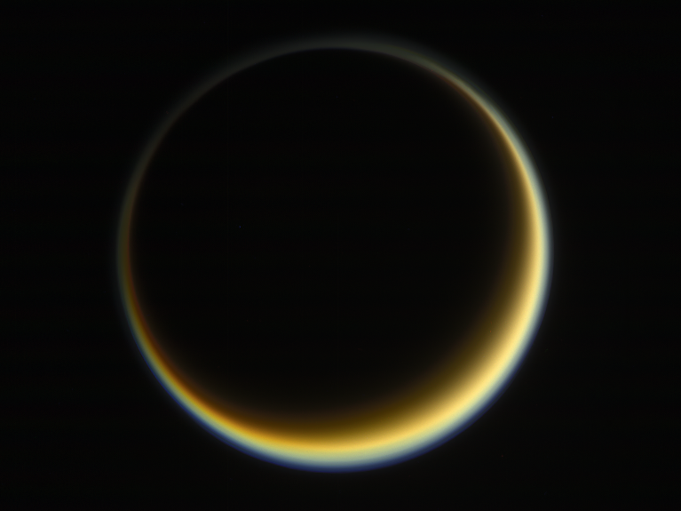
Disc-averaged data

Slide 7
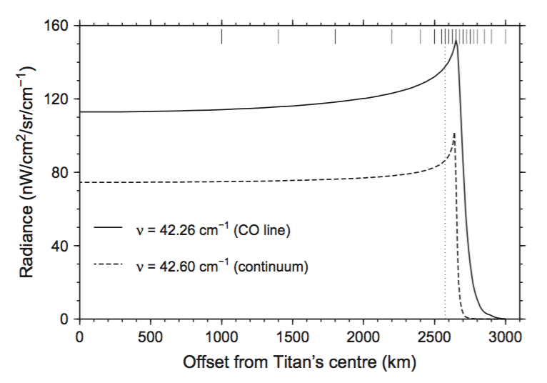
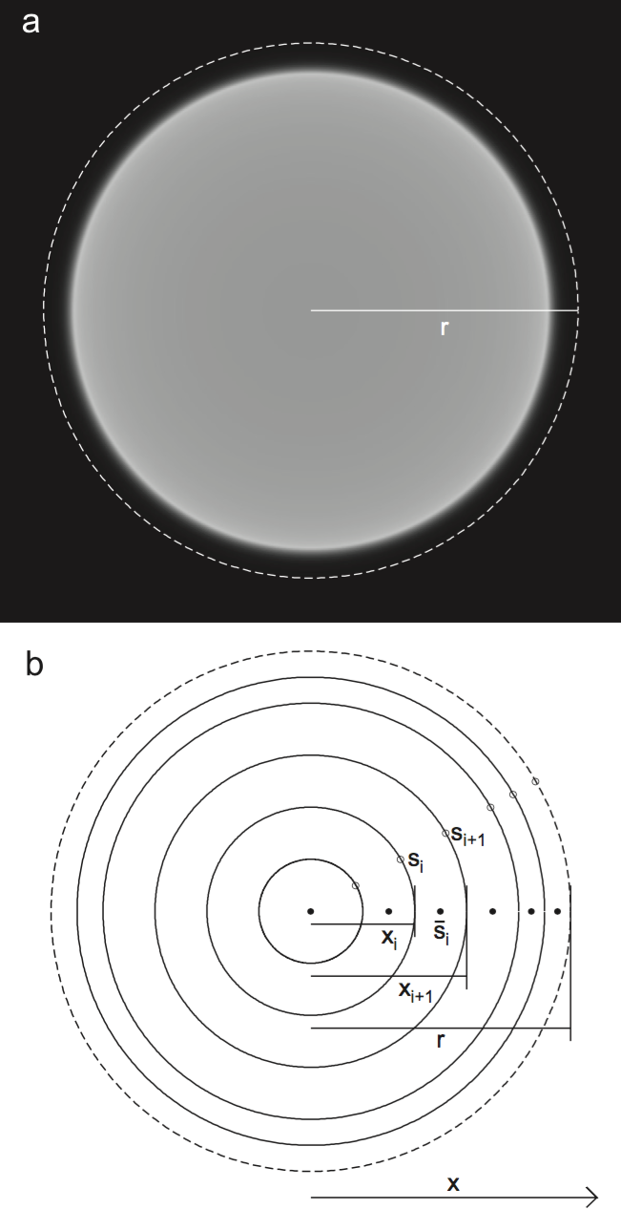
Disc-averaged spectra
Model the spectra as a weighted sum of P spectra
Each spectra represents and annulus with constant emission angle
Weights w_{i} defined by area of annulus
[Teanby et al. 2013]

Slide 8
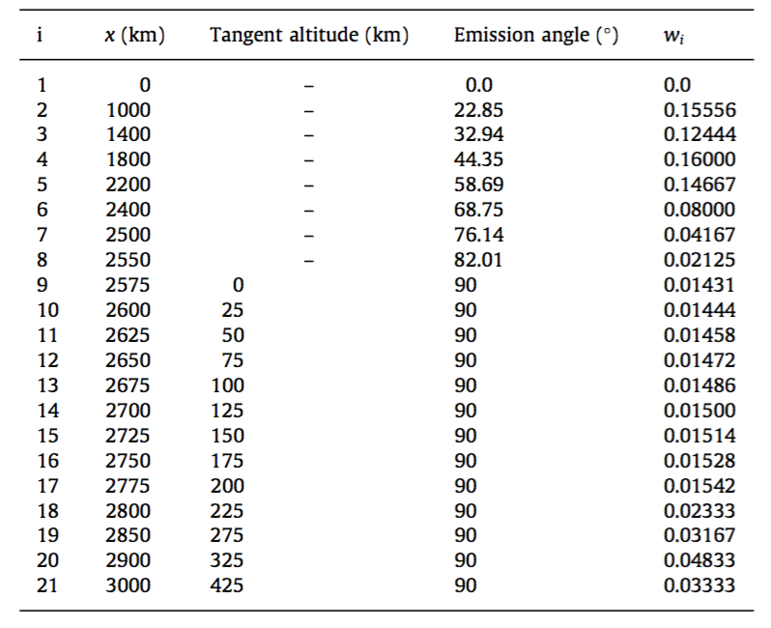
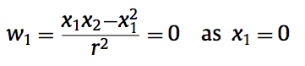
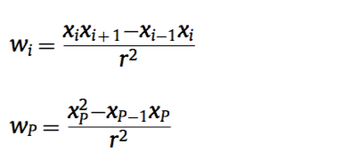
Disc-averaged spectra
Subtleties:
Calculating the weights?
[See: Teanby et al 2013]
How many points?
20-60?
More on limb usually
Depends on accuracy required
Where to put the points?
Need synthetic centre-limb curve
What distance to go to?
Where radiance drops to ~0
Checking it works?
Compare very fine grid to coarse grid
Differences should be < errorbars in data
[Teanby et al. 2013]

Slide 9
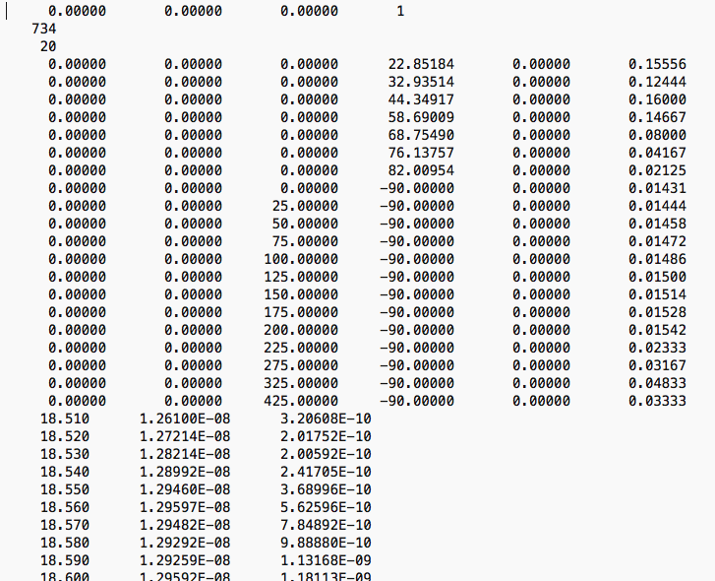
Disc-averaged spectra
.spx file

Slide 10
What if I can’t be bothered?
e = 45º (a bit rubbish but OK for quick retrievals)
Have a go on Nemesisdisc for analytical approx

Slide 11
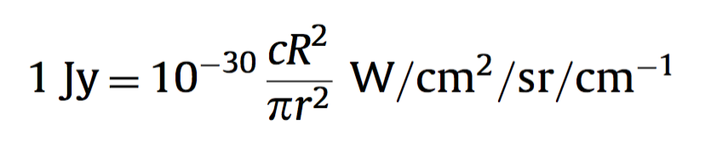
One more thing….
Disc-averaged spectra will be the spatially integrated radiance, ie. Irradiance
May be in a unit like Janskys
Easy to convert between Nemesis’ output (W/cm²/sr/cm⁻¹) and Jy (10⁻²⁶ W/m²/Hz)
c = speed of light in cm/s
R = distance to observer
r = radius over which you have integrated the radiance
(MUST be same as maximum r used for FOV averaging.
ie r is NOT the planet radius)
[All explained in Teanby et al. 2013]

Slide 12
Discussion points…
Future datasets
Cassini legacy
ALMA
JWST
Sofia
VLT etc
Recent/required development
linedata
CH4-N2 CIA a bit dubious, requires a x1.5scaling
N2 widths missing or guessed at
Lots of gases and variable linedata quality
high spectral resolution
double precision (now solved in recent update)
line database wavenumber resolution (G97 format not good enough)
non-LTE high atmosphere
2D retrievals (see Conor Nixon’s presentation)

